Slide 1
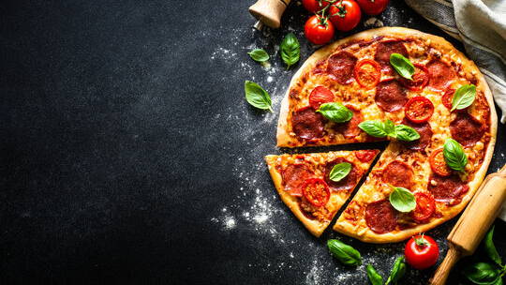
PIZZA SALES
ANALYSIS
SQL DATA ANALYSIS PROJECT
PREPARED BY TANMAY GURU

Slide 2
AGENDA
Table of Contents
01
02
03
Project Overview
SQL Analysis
Findings & Insights
Scope, tools, technologies, and project objectives for the pizza sales analysis
Query techniques, SQL concepts applied, and key business questions answered
Data-driven results, sales trends, category performance, and strategic recommendations

Slide 3
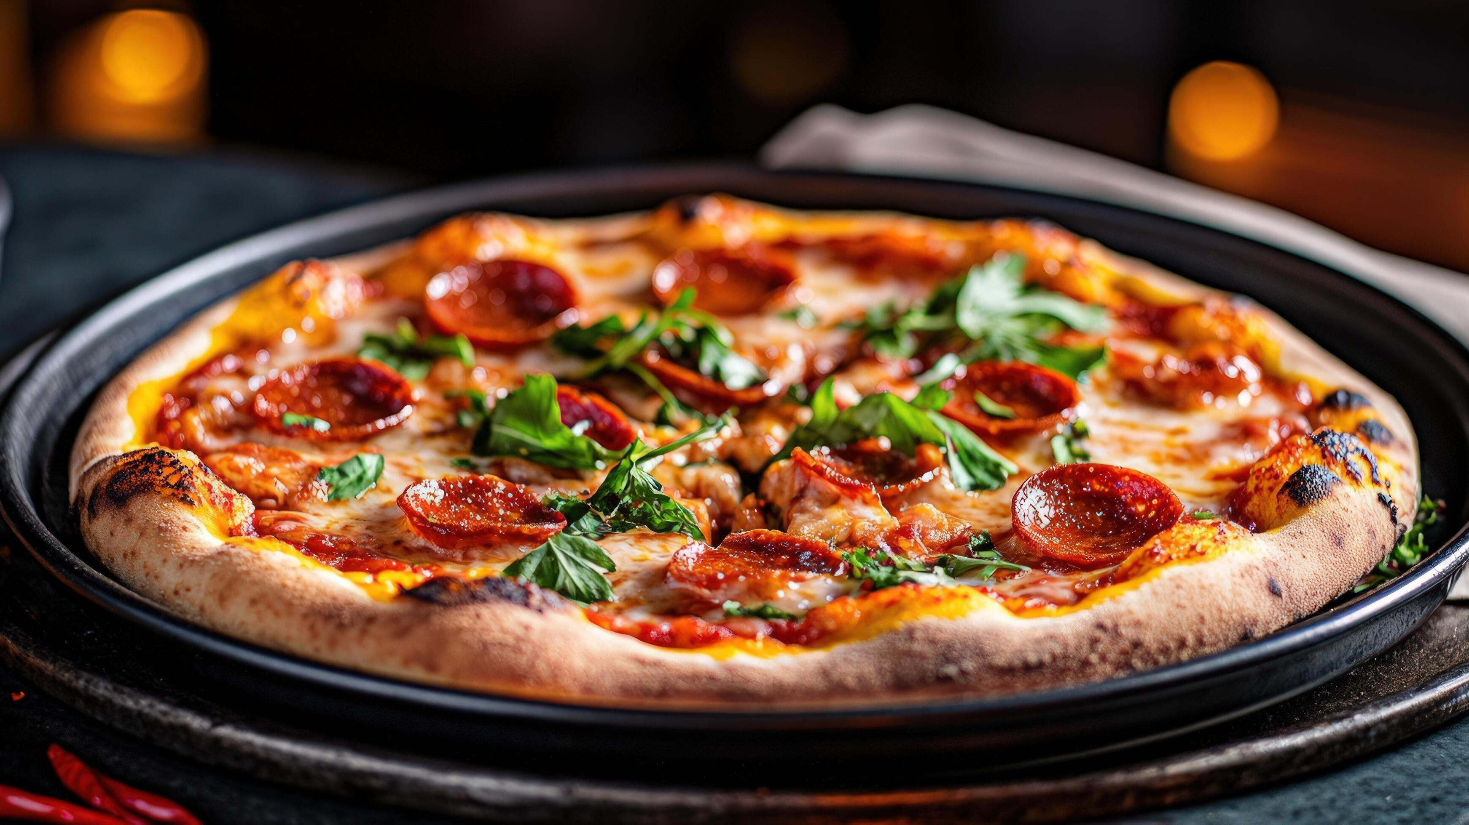
01
PROJECT OVERVIEW
Understanding the scope, tools, and objectives

Slide 4
Project Objectives
21,350
$817.9K
4
TOTAL ORDERS ANALYZED
TOTAL REVENUE GENERATED
PIZZA CATEGORIES
KEY OBJECTIVES
■ Analyzed 48,000+ pizza sales records using complex SQL queries across multiple related tables
■ Performed comprehensive data cleaning and transformation on raw order data to ensure data quality
■ Identified revenue patterns across pizza categories, types, sizes, and time periods
■ Generated actionable business insights to support menu optimization and inventory decisions
■ Built a reusable SQL analytics framework applicable to future sales analysis projects
04

Slide 5
Tools & Technologies
SQL (PostgreSQL)
Relational Database
Complex queries, joins, aggregations, window functions, and CTEs for data extraction and analysis
Structured data storage with normalized tables: orders, pizzas, order_details, and pizza_types
GitHub
Data Visualization
Version control, project documentation, and collaborative code management for the analysis
Bar charts, line charts, and pie charts to communicate findings clearly and effectively
TECH STACK OVERVIEW
The project utilized a 4-table relational database schema spanning orders, order_details, pizzas, and pizza_types. SQL queries ranged from simple SELECT statements to complex multi-level subqueries and CTEs. All analysis was documented and version-controlled on GitHub for reproducibility.
Key techniques included: JOIN operations across 4 tables, aggregate functions (SUM, COUNT, AVG), window functions (ROW_NUMBER, RANK), and CTEs for modular query design.
05

Slide 6

02
SQL ANALYSIS
Query techniques and business questions answered

Slide 7
SQL Concepts Applied
Joins
Aggregations
Combined orders, pizzas, and order_details tables using INNER JOIN and LEFT JOIN for comprehensive multi-table analysis
SUM, COUNT, AVG, MIN, MAX functions to compute revenue totals, order counts, and average order values across dimensions
Subqueries
Window Functions
Nested queries for complex filtering, ranking operations, and correlating data across multiple aggregation levels
ROW_NUMBER, RANK, DENSE_RANK for top-N analysis, running totals, and year-over-year comparisons
QUERY COMPLEXITY BREAKDOWN
CTEs (Common Table Expressions) were used extensively to build modular, readable queries. Complex analysis was broken into named temporary result sets, making each query self-documenting.
Total of 54 SQL queries written across all analysis dimensions, from data exploration to revenue attribution.
07

Slide 8
Business Questions Answered
1
Which pizzas generated the most revenue?
2
What were the peak sales periods?
→ Top 5 best-sellers identified. Thai Chicken Pizza leads at $43.4K in revenue
→ Peak hours mapped: 12-1 PM and 5-7 PM. Friday is the highest revenue day
3
Which categories performed best?
4
What is the average order value?
→ Classic leads in volume (26.9%), but Chicken has highest per-unit revenue at $24.0%
→ Average order value is $38.31, with large pizzas driving the highest ticket sizes
5
How does pizza size affect sales?
All 5 questions answered through 54+ SQL queries, generating actionable insights for menu planning, inventory management, and staffing optimization.
→ Large pizzas dominate at 45.9% of all orders, followed by Medium at 30.5%
ORDERS BY SIZE
PEAK ORDERING HOURS
08

Slide 9

03
FINDINGS & INSIGHTS
Data-driven results and strategic recommendations

Slide 10
Top-Selling Pizzas by Revenue
KEY INSIGHTS
3 of 5
top revenue pizzas are from the Chicken category
$43.4K
Thai Chicken Pizza leads all products in total revenue generated
$301.5K
combined revenue from just the top 8 pizzas shown above
Recommendation: Promote chicken specialty pizzas in marketing campaigns
10

Slide 11
Sales Trends & Category Performance
Summer Peak
Rush Hours
Friday Leader
Balanced Split
July and December show highest order volumes, indicating seasonal demand patterns
12-1 PM and 5-7 PM are peak ordering windows requiring optimized staffing
Friday generates the highest weekly revenue, 23% above the daily average
Revenue is evenly distributed across all 4 categories, ranging from 23.6% to 26.9%
11

Slide 12
Key Insights & Impact
KEY FINDINGS
RECOMMENDATIONS
Chicken category drives the highest per-unit revenue among all pizza types
1
Promote chicken specialty pizzas in marketing campaigns to maximize revenue per order
Large-size pizzas account for 45.9% of all orders — top inventory priority
2
Optimize large pizza inventory — ensure sufficient dough and toppings during peak periods
Peak hours (12-1 PM, 5-7 PM) need optimized staffing for demand surges
3
Staff up during peak hours (12-1 PM, 5-7 PM) to reduce wait times and capture demand
Classic category has highest order volume but lower per-order value
4
Bundle classic pizzas for higher AOV — pair with drinks or sides to increase ticket size
Project Impact: Improved understanding of sales performance | Demonstrated SQL analytics skills | Generated actionable business insights
12

Slide 13
THANK YOU
PIZZA SALES ANALYSIS PROJECT
SQL Data Analysis by Tanmay Guru
Questions?

